Slide 1


Barack & Michelle Obama Academy
GO TEAM MEETING
Wednesday, September 21, 2022 @ 4:45 pm

Slide 2
Meeting Agenda
(agenda may be amended)
This meeting allow for Public Comment
I
I. Call to Order
II. Roll Call; Establish Quorum
III. Action Items
a. Approval of Agenda
b. Approval of Previous Minutes
IV. Discussion Items
a. Continuous Improvement Plan Presentation
b. Fall MAP Data Review
V. Information Items
a. Principal’s Report
VI. Announcements
VII. Public Comment
VIII. Adjournment

Slide 3
I
Where we are –
Where we’re going?

Slide 4
Where We Are?
Our strategic plan is the guide for the work we’re doing in the school. By monitoring the plan and ranking priorities, we can all work towards the common goals. Using the priorities in the strategic plan, the school leadership team developed a Continuous Improvement Plan (CIP) for the current school year.

Slide 5
Timeline for GO Teams
1
2
3
4
5
Fall 2021
GO Team Developed 2021-2025 Strategic Plan
Summer 2022
School Leadership completed Needs Assessment and defined overarching needs for SY22-23
August 2022
School Leadership completed 2022-2023 Continuous Improvement Plan
Sept. – Dec. 2022
Utilizing current data, the GO Team will review & possibly update the school strategic priorities and plan
Before Winter Break
GO Team will take action (vote) on the rank of the strategic plan priorities for SY23-24 in preparation for budget discussions.

Slide 6
Discussion Items
Current Strategic Plan
Continuous Improvement Plan
  Needs Assessment
  SMART GOALS
  Monitoring Measures
MAP Data
  Data Protocol

Slide 7
2021-2025
STRATEGIC PLAN

Slide 8
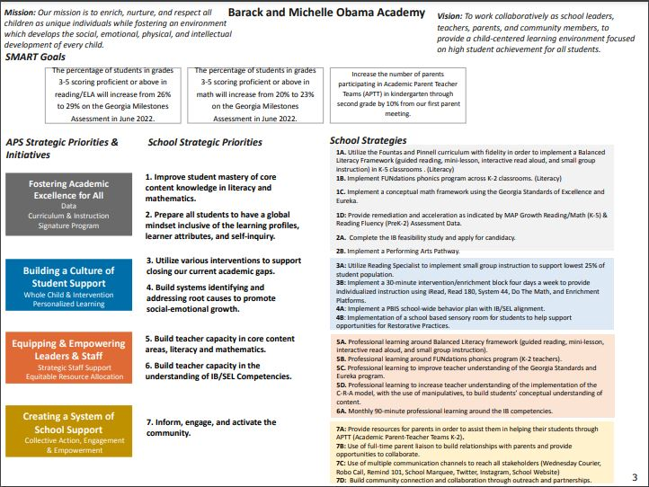
Notes:
https://www.atlantapublicschools.us/cms/lib/GA01000924/Centricity/Domain/11671/School%20Strategic%20Plan%20Workbook%20and%20Template_BAMO_Updated%201.12.21.pdf

Slide 9
CONTINUOUS IMPROVEMENT PLAN
SY 2022-2023

Slide 10
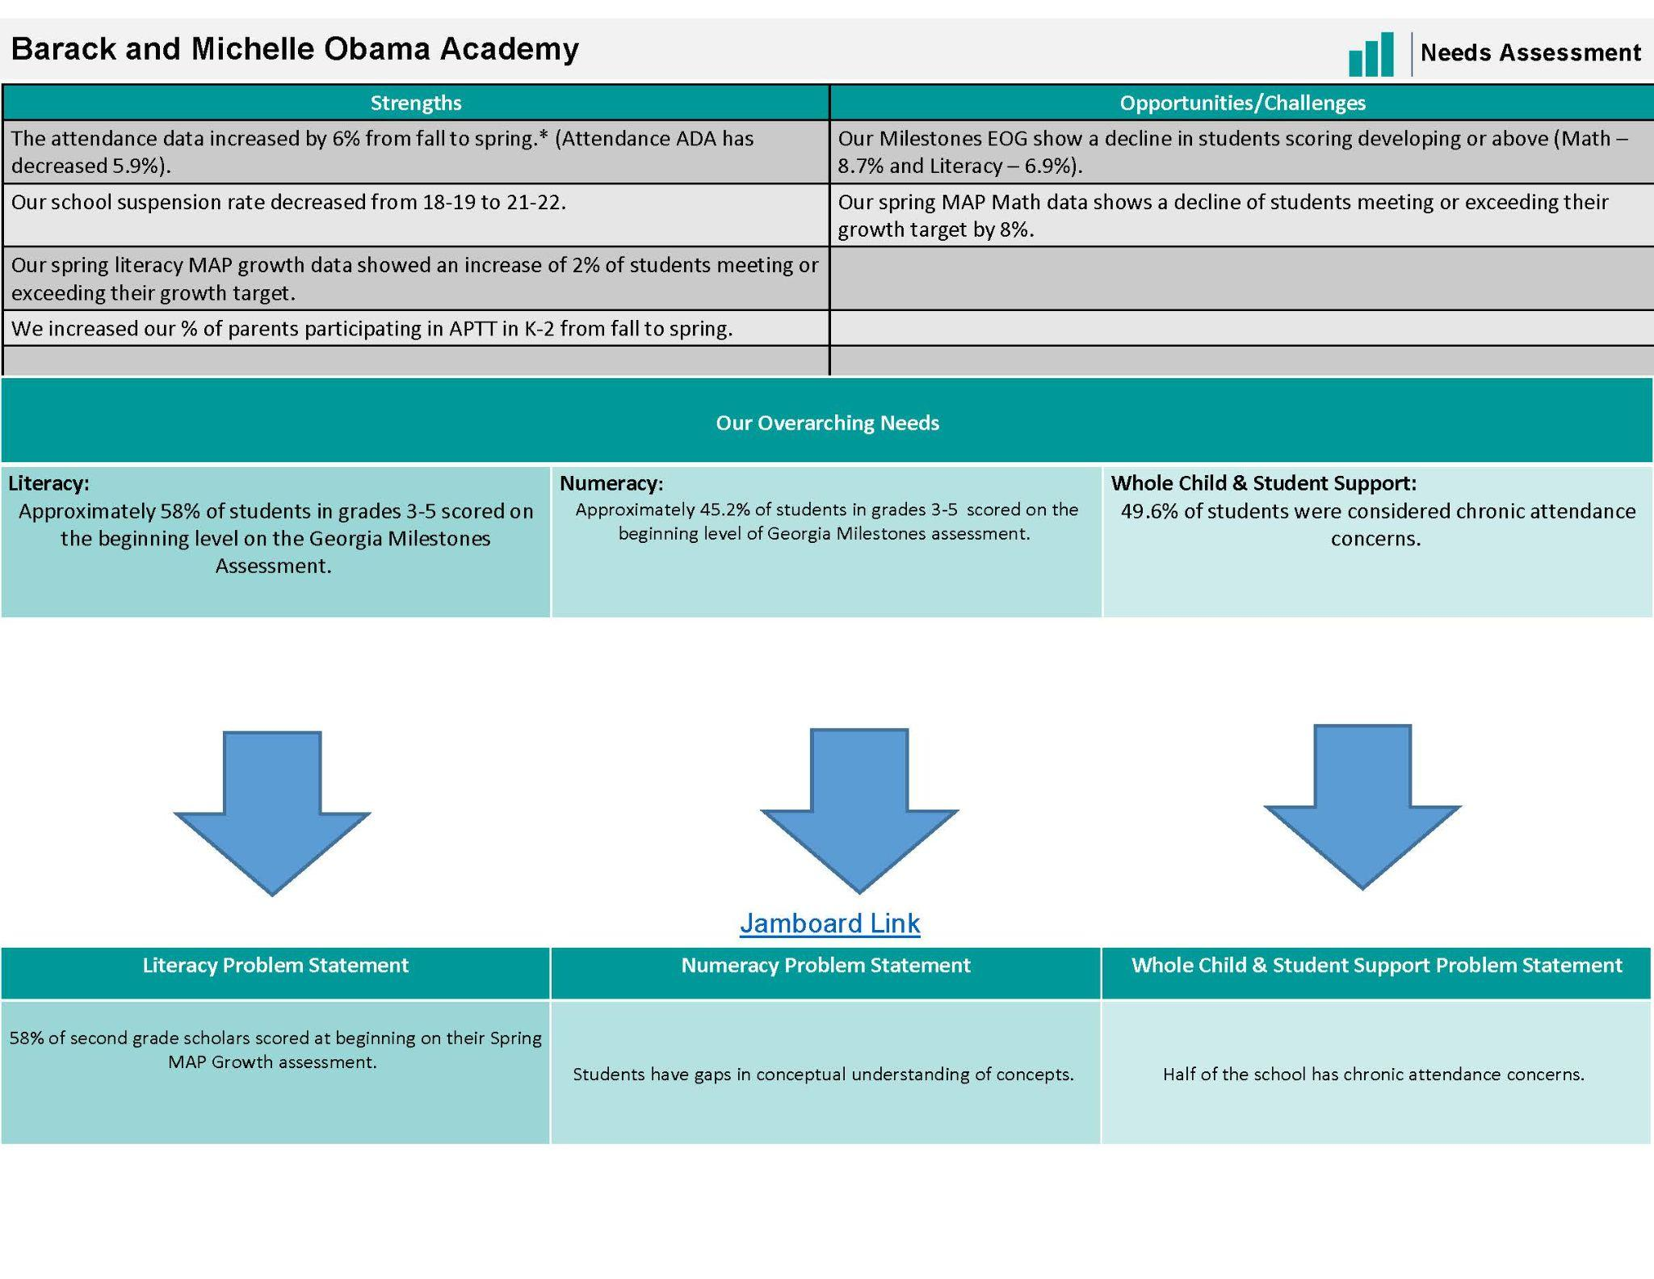

Slide 11
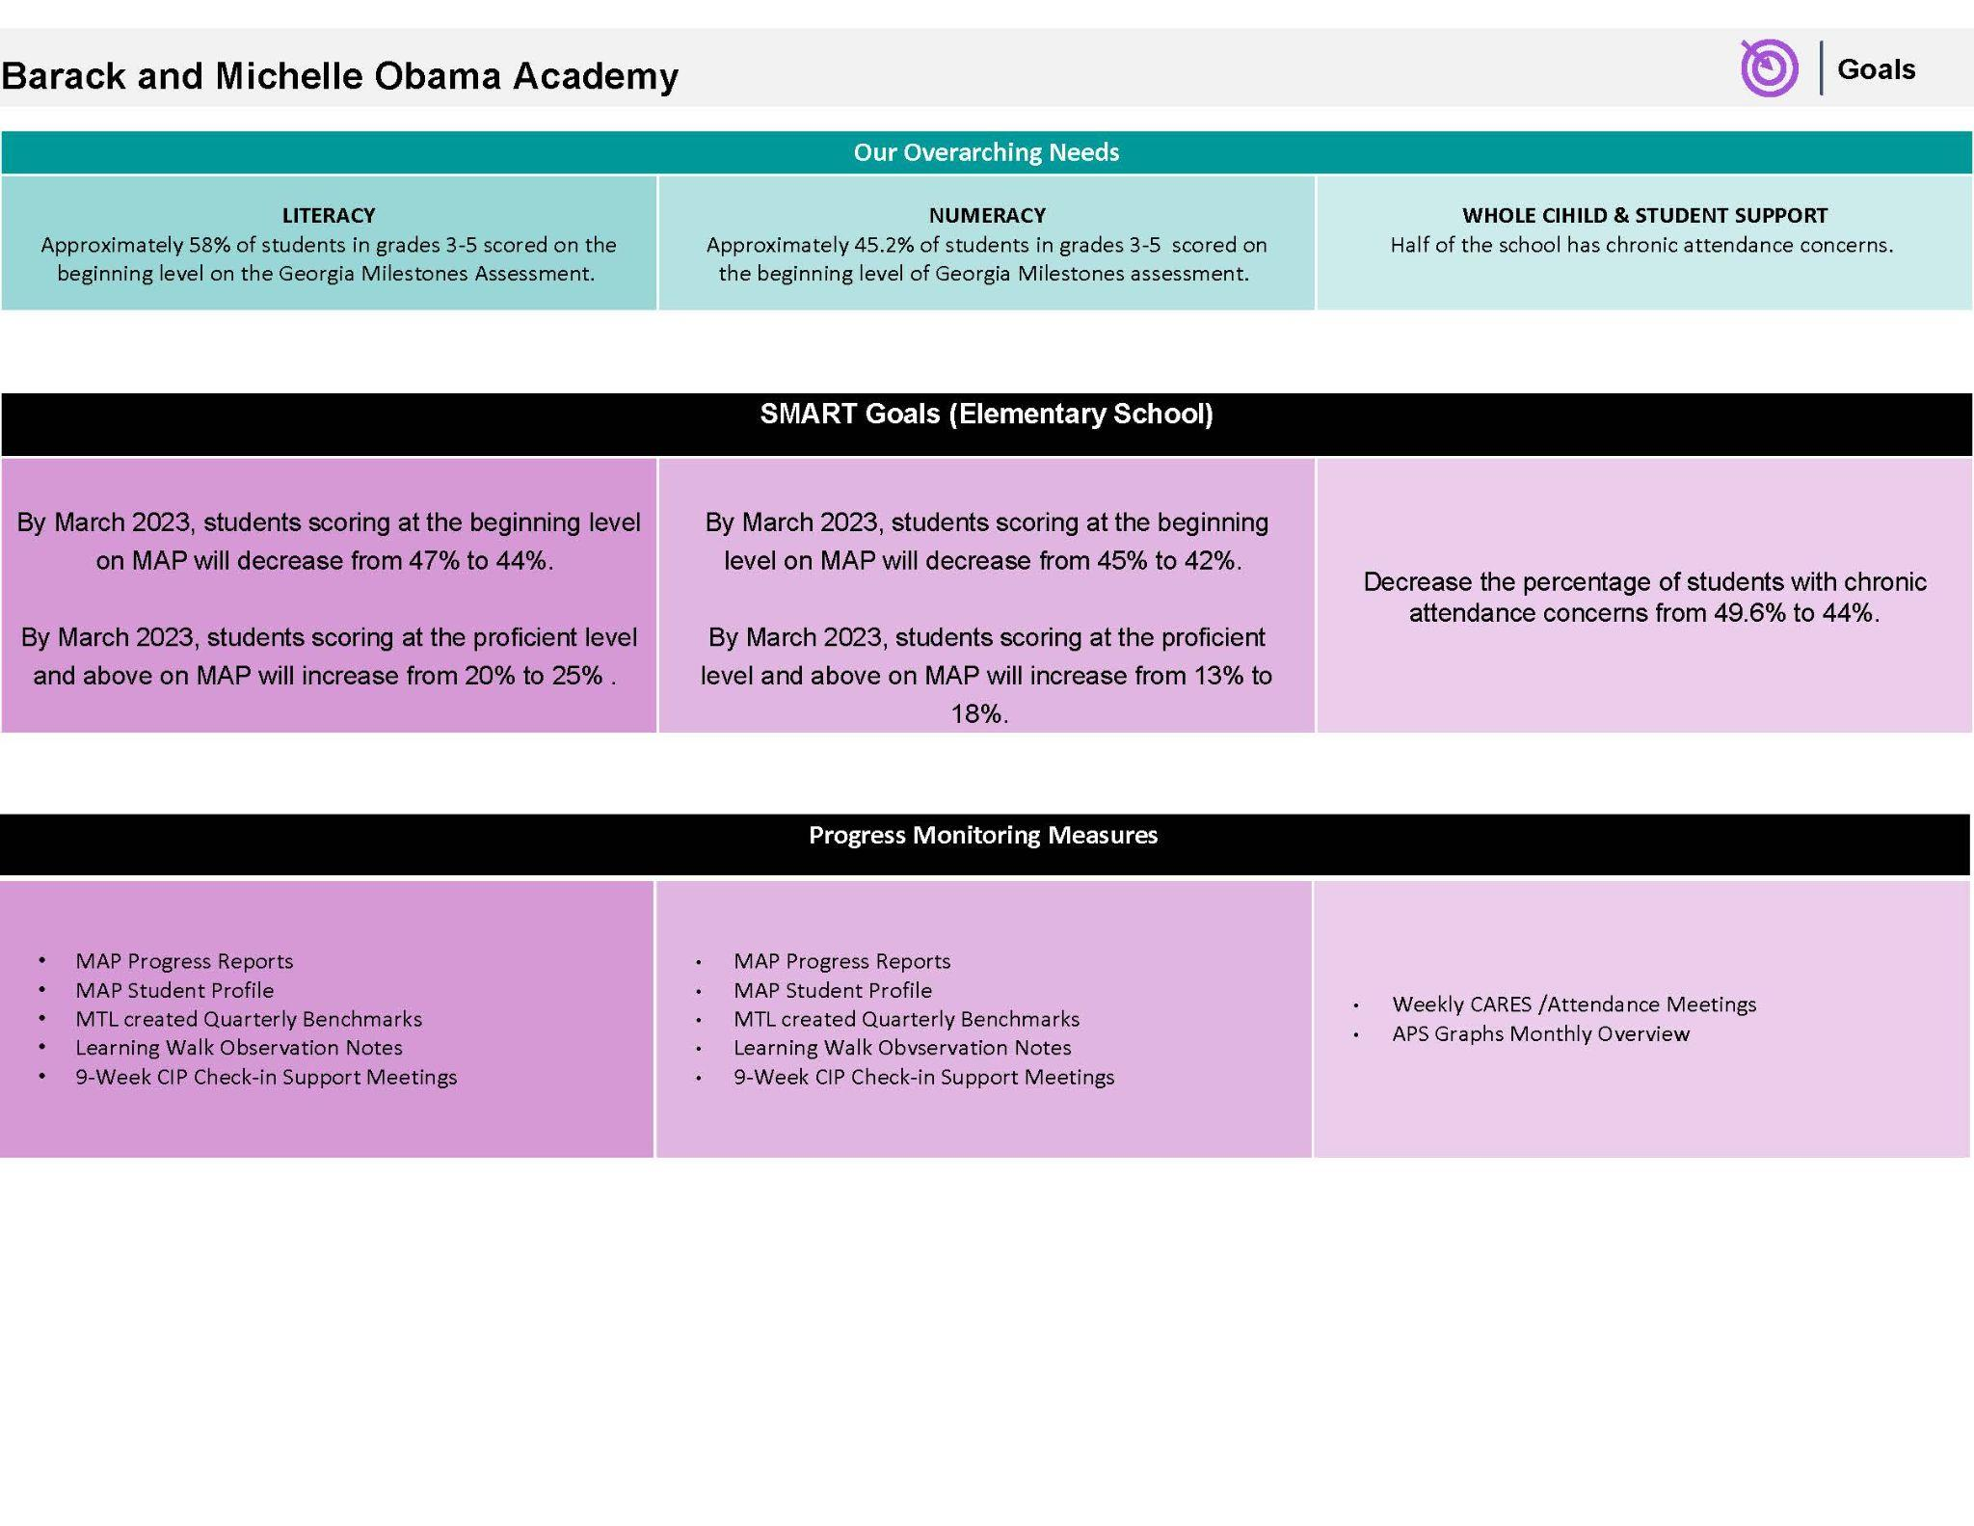

Slide 12
Progress Monitoring Measures
Literacy
Numeracy
Whole Child
MAP Progress Reports
MAP Student Profile
MTL created Quarterly Benchmarks
•Learning Walk Observation Notes
•9-Week CIP Check-in Support Meetings
MAP Progress Reports
MAP Student Profile
MTL created Quarterly Benchmarks
Learning Walk Observation Notes
9-Week CIP Check-in Support Meetings
Weekly CARES /Attendance Meetings
APS Graphs Monthly Overview

Slide 13
MAP DATA
Literacy
Math
2% DI
4% DI
1% DI
2% DI

Slide 14
MAP DATA
Literacy
Math

Slide 15

GO Team Discussion:
Data Protocol
What do you notice?
What are your wonderings?
What addition questions do you have?

Slide 16
Strategic planning will help you fully uncover your available options, set priorities for them, and define the methods to achieve them.
Robert J. Mckain

Slide 17
Where we’re going
At our next meeting(s) we will discuss how our data is aligning to our strategic plan and determine if we need to make any adjustments.
Before we leave for Winter Break, we will take Action (vote) on ranking our strategic priorities for the 2023-2024 school year.
Let me or the Chair know of any additional information you need for our future discussion.

